Slide 1
Gadabout Gaddis Guide to Sizing And Operations
More Than One Way to Catch Fish
Tony Gaddis
Principal Performance Architect

Slide 2
Fishing
A Lot of Different Ways to Catch Fish
Fly Fishing to Dynamite
The More You Have Your Hook and Bait in the Water
The More Likely You Are to Catch Something
Be Efficient
Gadabout Gaddis Approach
There is No Such Thing as a Universal Truth
But It Works for me…

Slide 3
Sizing
What Type of Science?
Newtonian
Relativistic
Gadabout Gaddis Sizing Uncertainty Principle
You can’t know all you wish you knew
IO size/address mix
How an application will change over time
What tomorrow’s new workload will require
Reductive Thinking is Dangerous
There is no such thing as an 8KB R/W Mix Workload
IO “Cost” can vary dramatically

Slide 4
“Quantum Mechanics” Sizing #1
If Known Workload on NetApp Storage
Choose Controller Model and Number to Provide the Required Workload IOPs (if Known and Projected)
Relativistic Modeling
If Unknown/Foreign Workload
Estimate Workload
Controller Models to Provide “Buckets”, Fill “Buckets” to Performance Capacity
Add “Buckets” as Necessary

Slide 5
“Quantum Mechanics” Sizing #2
Match Disks and Caching Technology Performance Capacity to Controller Performance Capacity
Choose Spindle Technology/Capacity Based on Average IOPs/TB of Workloads
Create Tiers for Efficient Performance/Capacity Utilization

Slide 6
Starting Footprints – Think of Buckets
Aggregates - Matching Disk Performance to Controller Performance
Minimum
SAS
8020 3 shelves/controller; 1 aggr
8040 4 shelves/controller; 1 aggr
8060 5 shelves/controller; 1-2 aggr
8080 6-10 shelves/controller; 2 aggr
SATA
Be careful!

Slide 7
Starting Footprints – Flash #1
For all practical purposes:
Flashcache, Flashpool equivalent from performance perspective
Flashpools are persistent and aggregate focused caching
Some differentiation for corner case workloads
For Sequential Write/Read workloads
Flashcache Lopri; Sequential Read
For a Random Write/Read workloads (TPCC)
Flashpool

Slide 8
Starting Footprints – Flash #2
Flash Cache per controller
8020 1TB Flash Cache
8040 2TB Flash Cache
8060 2-4TB Flash Cache
8080 4TB Flash Cache
Flash Pool per controller
8020 ½ shelf
8040 ½ shelf
8060 ½ shelf
8080 1 shelf

Slide 9
VM Workload IOPs at 50% Node Utilization
8080 ~27-30KIOPs/node
8060 ~18-20KIOPs/node
8040 ~12-14KIOPs/node
8020 ~8-10KIOPs/node

Slide 10
Disk Sizing Rules of Thumb #1
ONTAP is a random, moderate sized IO workload to disks
Reasonable approach is
1:1 front end IOPs to disk IOPs
Reduce by 25% for caching
calculate minimum data spindles
SAS – 120 IOP/s
SATA – 80 IOP/s

Slide 11
Disk Sizing Rules of Thumb #2
If sizing for sequential workload
SAS – 7.5MB/s
SATA – 5MB/s
Flash Cache/Pool not as impactful to workload

Slide 12
IOPs/TB
Typically a Multi Peak distribution
Consider grouping into 3 classes
Match to Disk Architecture
SSD – 1250-625 IOPs/TB (1000+ IOPS/800GB-1.6TB)
SAS – 150-100 IOPs/TB (120 IOPS/800GB-1.2TB)
SATA – 40-20 IOPS/TB (80 IOPS/2TB-4TB)
Optimal Design
Match Aggregate/Disk Technology to IOPs/TB
Use OPM and Volmove

Slide 13
AFF The Big Hammer
8080 2 shelves/controller

Slide 14
Buckets – Don’t Spill Your Water!
Performance Management – A Longer Discussion
Controllers
Water Mark:
Maximum of
Processor utilization
Cleaning process
Aggregates
Water Marks:
Aggregate Free Space
Disk Busy

Slide 15
Additional Thoughts
Separation of Workloads ie Different Buckets
Exchange/Sharepoint/CIFS shares all have a looser latency SLA and run at a higher performance utilization
MS SQL typically has poorly written queries that read/write in burst
Oracle tends to be well behaved; latency matters a lot; table space striping
VDI is “normal”; latency matters a lot
VSI watch the Sharks – another discussion

Slide 16
Sharks and Peanut Butter

Slide 17
Reading
Black Swan by Taleb
Most interesting things in life are not normal distributions; they are power law
Power Law distributions have
Big Winners
Catastrophic, unanticipated failures
Linked by Barabasi
Explains how Power Law distribution form
Survivability, Vulnerability

Slide 18
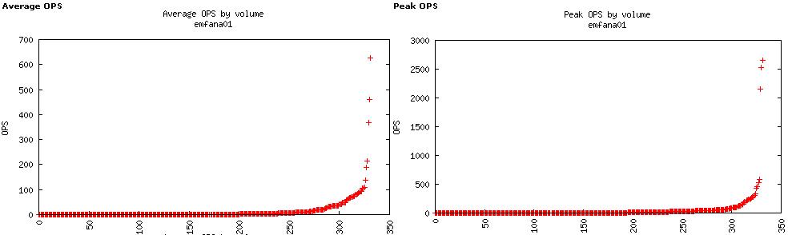
IOPs/Volume - IT environment

Slide 19
Sharks – Separate Tanks (Buckets)
Applications/Volumes Typically Follow Power Law Distribution
Few with Many
Many with Few
Few with Many (IOPs) Are Your Sharks
Across the Cluster
Know what Buckets Your Sharks Are In
Best Practice
Keep your Sharks in Separate Controller Buckets
Or In Separate QoS Defined Workloads

Slide 20
Peanut Butter
Non Sharks
“Many with Few”
Spread Them Evenly
Like Peanut Butter on Bread ☺

Slide 21
BammBamm Performance Lessons

Slide 22
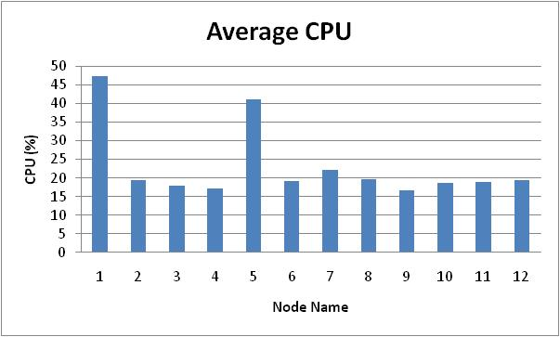
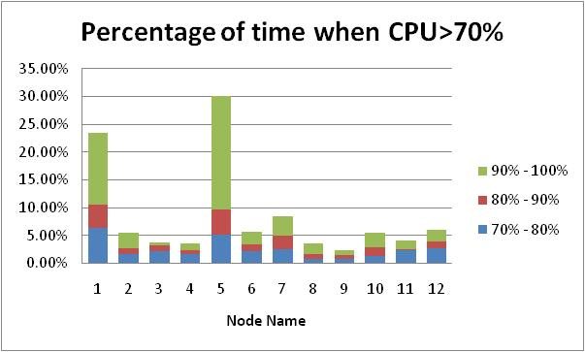
CPU Utilization Across the Cluster
BammBamm Cluster Analysis
Daemon on 2 and 5
Main on 2
FSB_RR on 5
Flexclone workspaces on 2 and 5
Flexclone workspaces VolMoved nightly to other nodes
Note -Node 1 results are not accurate; actually more like all nodes other than 5
NetApp Confidential -- Do Not Distribute
22

Slide 23
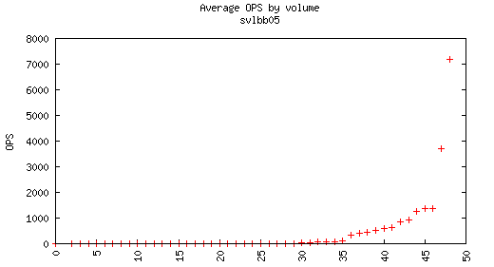
IOPs/Volume – BammBamm Node 5
Top Volumes
cherylt_frr_bt_11_18_1221048_11181552, 395
rommel_fsbsmb2b_1220950_11181411, 459
yyan_burt_463073_2_1221142_11181854, 513
DOT_Rbr_to_main, 593
swkuo_fsb2_1221124_11181724, 619
junx_fsb_rr_1220842_11181141, 627
pankajg_fsbrr_434083_work_1220950_11181346, 651
pankajg_fsbrr_434083_new_1220950_11181353, 697
tolson_fsb_ab6_1221135_11181827, 759
vedran_fsb_man2_1220218_11180939, 867
farshid_fsbrr_463135_1_1220923_11181252, 930
lakhera_fsb_rr_ifix_1220218_11181114, 1260
ananthan_vmovreplsub_1221106_11181721, 1304
vedran_fsb_man3_1220218_11181300, 1357
ctim_burt_413759_submit_1220798_11181024, 1359
madhura_cntmsg1_1220972_11181429, 2442
boopathy_SVL_461597_1221217_11182215, 3720
DOT_fsb_rr, 7181

Slide 24
Clustered ONTAP for Performance
Deal with Black Swans ie “Sharks”
Manage the high IOPs Volumes
Vulnerability
“Sheet Metal” QoS for Daemons
Isolation
Volmove as workload fluctuates
Distribute the rest of the workload evenly
Snapmirror Daemon copies throughout cluster
Round robin Workspace/Flexclone creation

